Slide 1

Notes:
Welcome
Introduce yourself

Slide 2
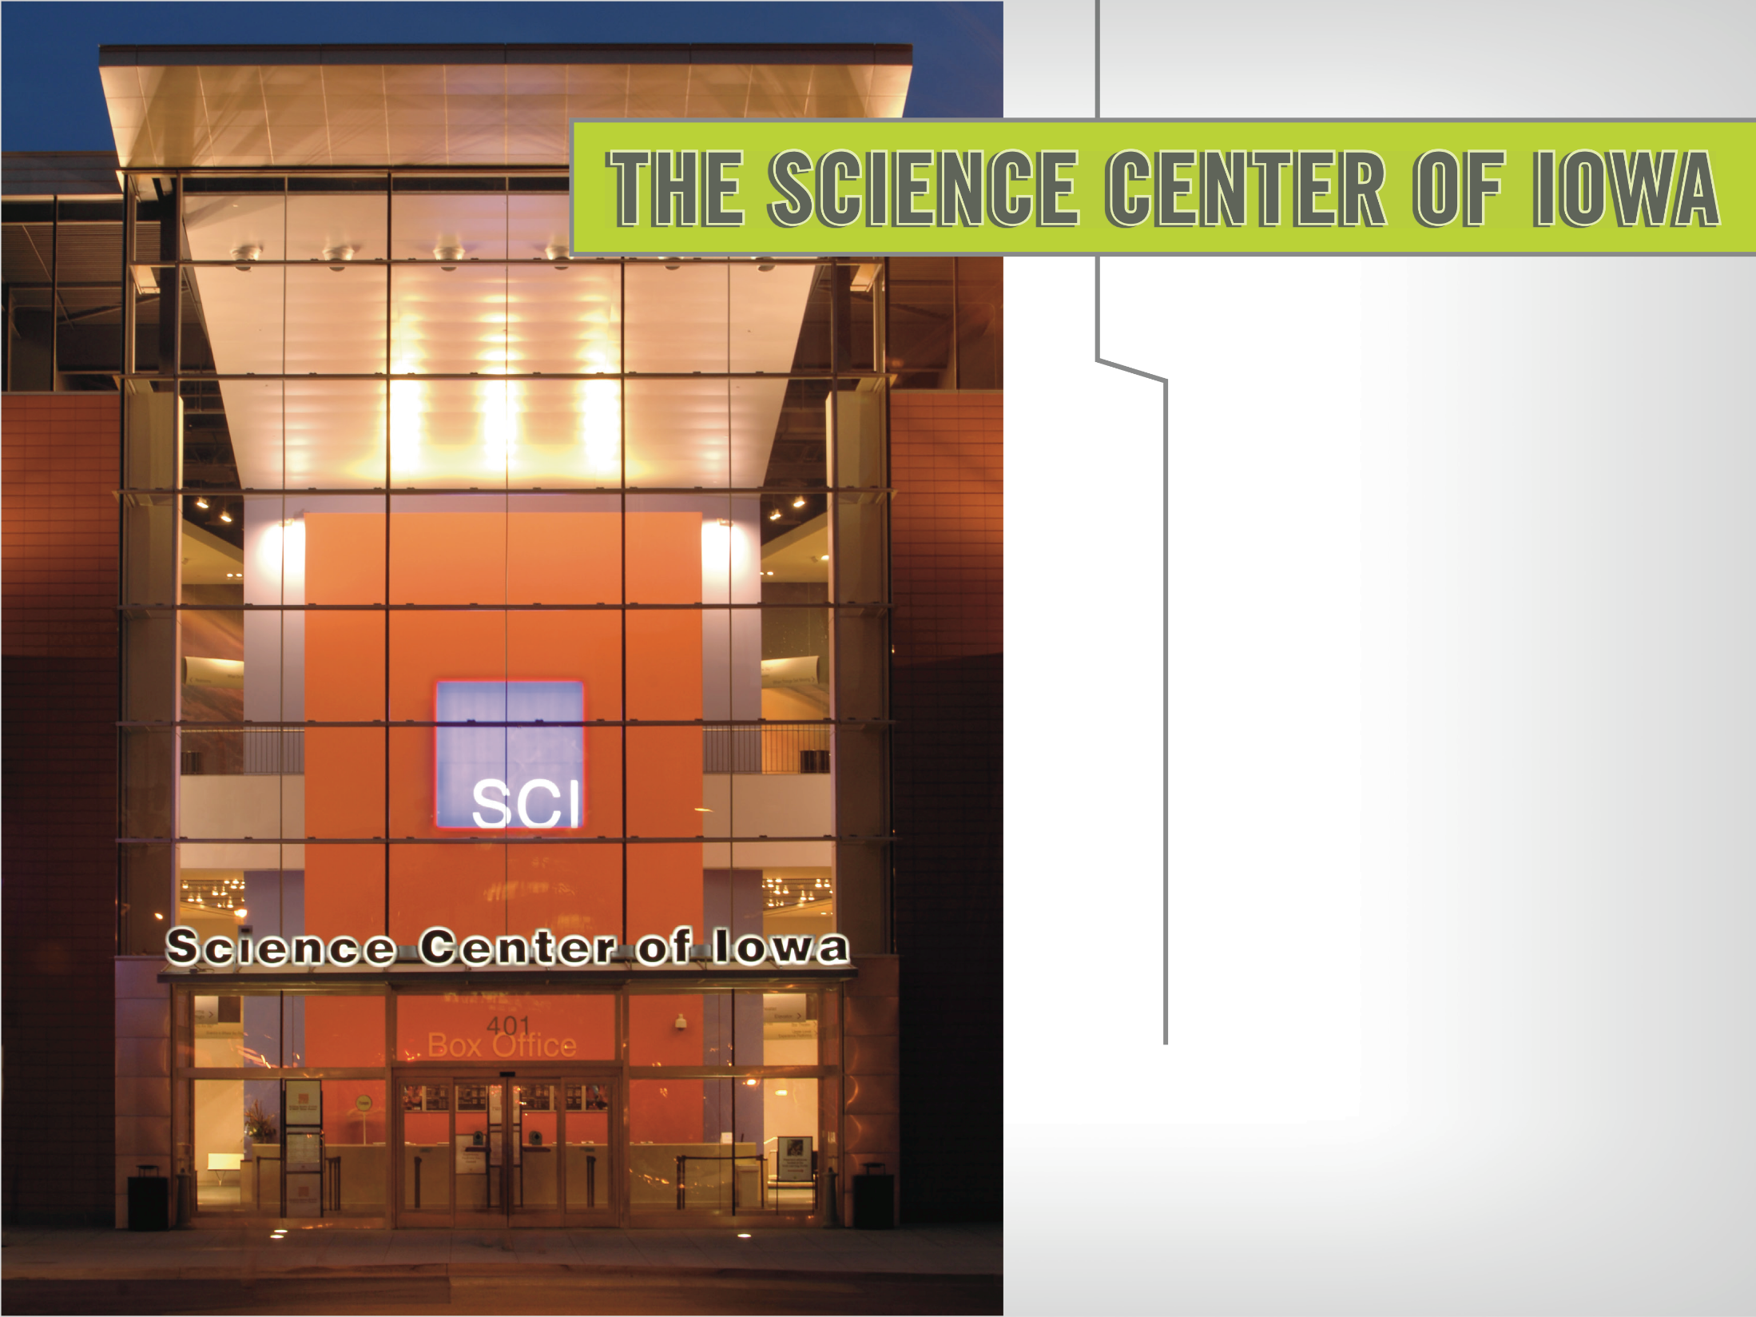
Founded in 1970
One of the first science museums to operate an onsite preschool
More than 300,000 participants annually
501(c)(3)
Notes:
The Science Center of Iowa & Blank IMAX Dome Theater was founded in 1970 in Greenwood-Ashworth Park as one of the first interactive science museums in North America.
In 1975, we established the SCI Preschool and became one of the first science museums to operate an onsite preschool.
In 2005, we moved downtown to our current location along MLK Parkway.
Today, we serve more than 300,000 people each year through onsite and offsite programming

Slide 3

ENGAGING AND INSPIRING IOWANS
ALONG THEIR JOURNEY OF
LIFELONG SCIENCE LEARNING.
We value:
Safety | Compassion | Integrity | Innovation
Notes:
Our mission is to engage and inspire Iowans along their journey of lifelong science learning
We value SAFETY, COMPASSION, INTEGRITY AND INNOVATION

Slide 4
Notes:
We truly are the Science Center of IOWA.
We engage participants from Iowa’s 99 counties and beyond through school visits and live school demonstrations, discovery labs, science camps, professional development opportunities for educators and many other onsite and offsite programs
Later on Patrick will be sharing with you all about those opportunites and experiences SCI has that might be a good fit for your work. In essence we see ourselves as a partner to serve Iowans on their journey,

Slide 5
WHO WE SERVE
EARLY CHILDHOOD
Onsite experience, School Groups, Camps, SCI Preschool, Pint Size Science & Toddler-Edition classes, Family STEM Institute
YOUTH
Onsite experience, School Groups & Labs, Camps, Girls in Science Initiative,
Events (FIRST LEGO League, Ready Set Build, Des Moines Mini Maker Faire)
HIGH SCHOOL
Onsite experience, School Groups & Labs, Jr. Camp Counselors, Girls in Science Initiative, Events (LIVE! From The Heart, Pantheon Project), Volunteer Opportunities
EARLY- & MID-CAREER
Onsite experience, Mixology Night, Star Parties, Des Moines Mini Maker Faire,
Volunteer Opportunities (mentors for Girls in Science programs)
LIFELONG LEARNERS
Onsite experience, Mixology Night, Star Parties, Family STEM Institute,
Volunteer Opportunities (science communication volunteers)
Notes:
(Brief overview of audiences – maybe highlight one or two programs in each category)

Slide 6
Notes:
Outreach opportunities

Slide 7
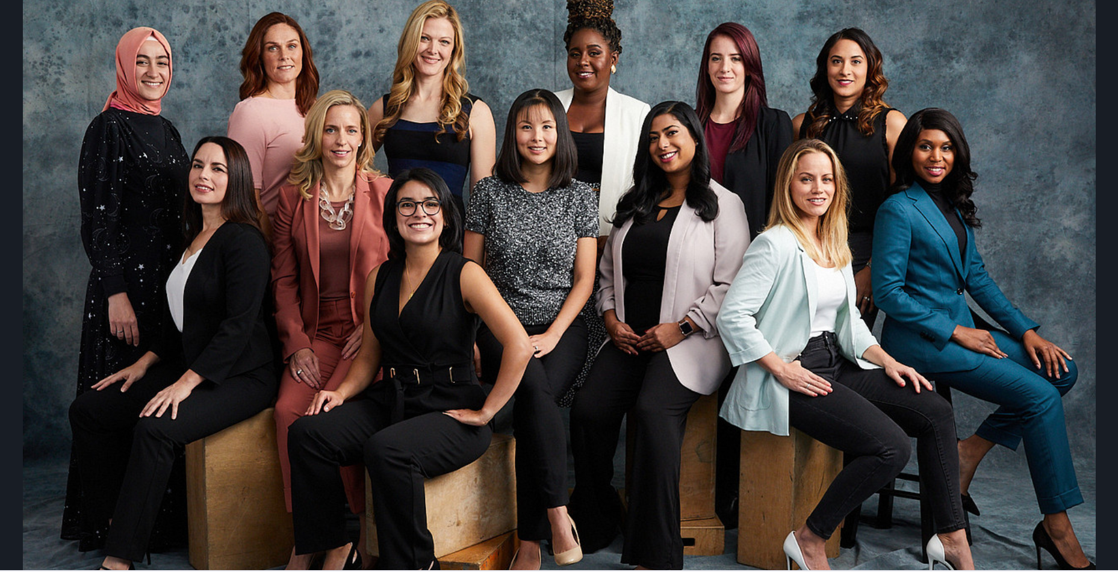
Notes:
The Iowa Active Learning Community Partnership today is thrilled to unpack and discuss the topic girls in science.
Women remain underrepresented in the science and engineering workforce, although to a lesser degree than in the past, with the greatest disparities occurring in engineering, computer science, and the physical sciences (NSF, Science & Engineering Indicators, 2016).
For more than 20 years the percentage of women receiving under grad degrees in engineering has been flat, 18-21%
in computer science we have seen a decline from 28-19%
Women make up half of the total U.S. college-educated workforce, but only 29% of the science and engineering workforce.
Why does it matter? Thoughts in comments?
Research shows that increase innovation, unique perspectives, increase creativity when women are more equally at the table in stem careers.
It also shows that a collective result is that
It boosts economies
Increases productivity
Results in more accurate scientific reasoning
NASA has more recently been sharing ways they too are addressing gaps in equity.
They recently launched the most powerful space telescope ever. In choosing WHO whose research proposals in ways to use this tool were selected to wor to remove the unconscious bias or prejudices to be focused on the merit of the proposal rather than who submitted it.
They assessed every proposal without knowing who submitted so all you can see is the science. It is a shi8ft from the selection of the Hubble Space Telescope where it was felt that not everyone got equal consideration. Research showed that -proposals that were led by women had a lower acceptance rate than proposals led by men. When using the blind proposal approach, for the first time ever, the acceptance rate for proposals led by women was higher than the acceptance rate for proposals led by men. The gender difference had flipped.
This one example of addressing,
.

Slide 8
Girls In Science
The Girls in Science initiative, SCI works to promote early and prolonged engagement in STEM (science, technology, engineering and math) in an effort to encourage career development and a more diverse workforce for the 21st century.
Notes:
To this end, SCI is working on a variety of strategies to support gender equality in the STEM workplace in informal learning
Focus is using gender equitable teaching strategies to engage girls in STEM learning and workforce
Although the initiatives is focused on gender equity it too focuses on lifting both girls and boys. Designed activates and experiences through a partnership with Twin Cities PBS and National Girls Collective called SCI Girls which outlines 7 characteristics of stem learning that engages girls…research is clear
Share scigirls 7
Girls benefit from collaboration, especially when they can participate and communicate fairly
Girls are motivated by projects they find personally relevant and meaningful
Girls enjoy hands-on, open-ended projects and investigations.
Girls are motivated when they can approach projects in their own way, applying their creativity, unique talents, and preferred learning styles.
Girls’ confidence and performance improves in response to specific, positive feedback on things they can control—such as effort, strategies, and behaviors
Girls gain confidence and trust in their own reasoning when encouraged to think critically
Girls benefit from relationships with role models and mentors.
http://tpt.vo.llnwd.net/o26/scigirls/ScigirlsSeven_Print.pdf

Slide 9
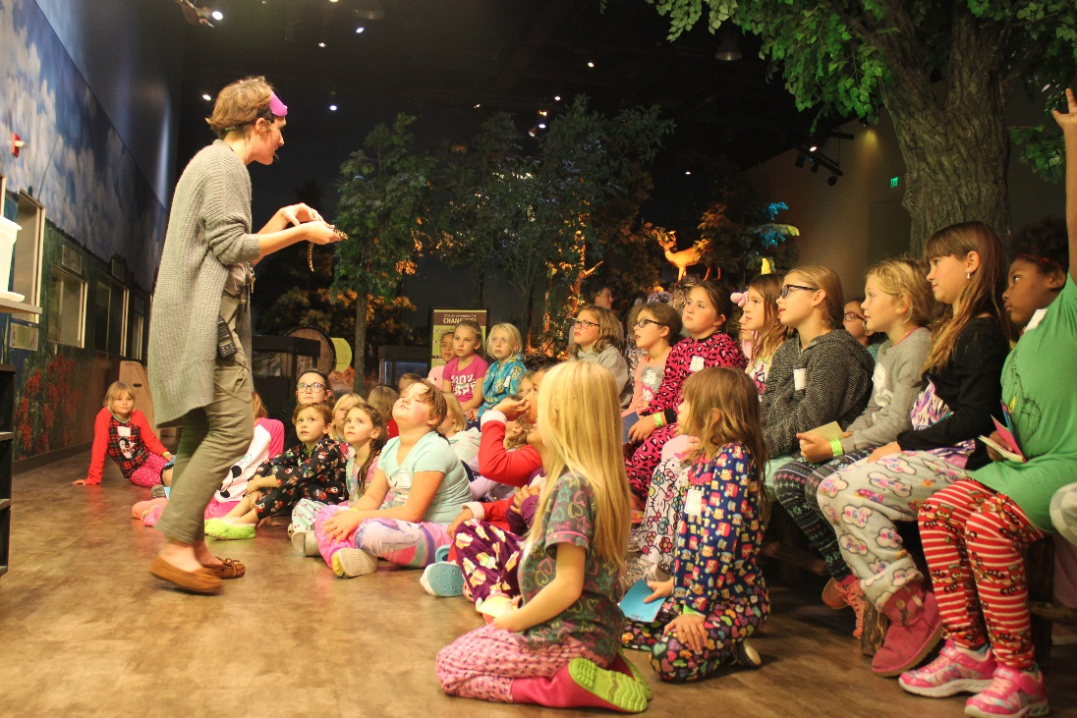
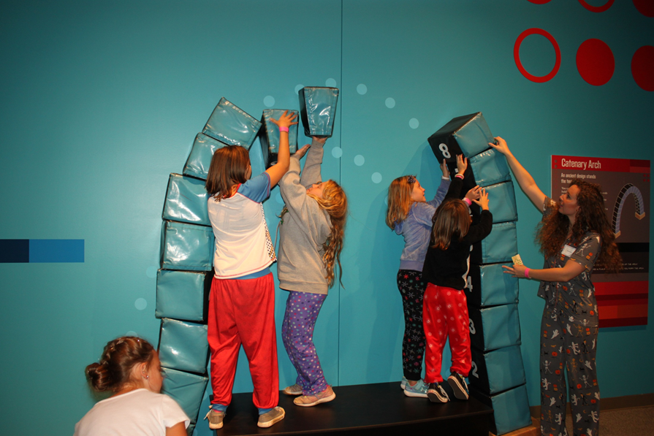
Girls in Science PJ Party
Dreaming Big starts Early
Notes:
Targeted for girls ages 8-15, when many students begin thinking about what they want to be when they grow up, the goal of this event is to inspire girls to dream big. This event works to demonstrate how science can be an integral part of their future as well as provide an opportunity for girls to meet peers who may share a common interest. Activities include getting-to-know-you games, a ‘Star Party’ featuring telescope viewings of the planets, a live science demonstration and local women from STEM fields sharing their lives and discussing their careers.
Research shows that
Girls benefit from collaboration, especially when they can participate and communicate fairly. Girls thrive when they work together to make STEM intentionally a social experience
Girls enjoy hands-on, open-ended projects and investigations. SciGirls promotes exploration, imagination, and invention. Encourage your girls to ask questions and find their own paths for investigation. (
Girls enjoy hands-on, open-ended projects and investigations. Educators can encourage and promote exploration, imagination, and invention by encouraging girls to ask questions and find their own paths for investigation

Slide 10
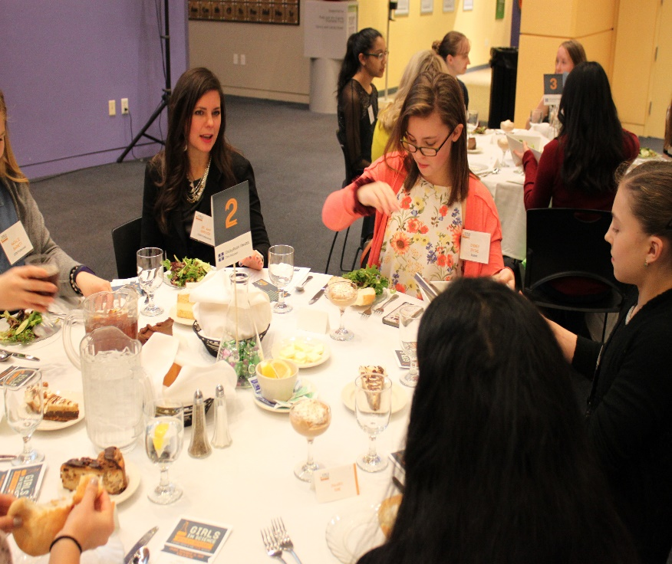
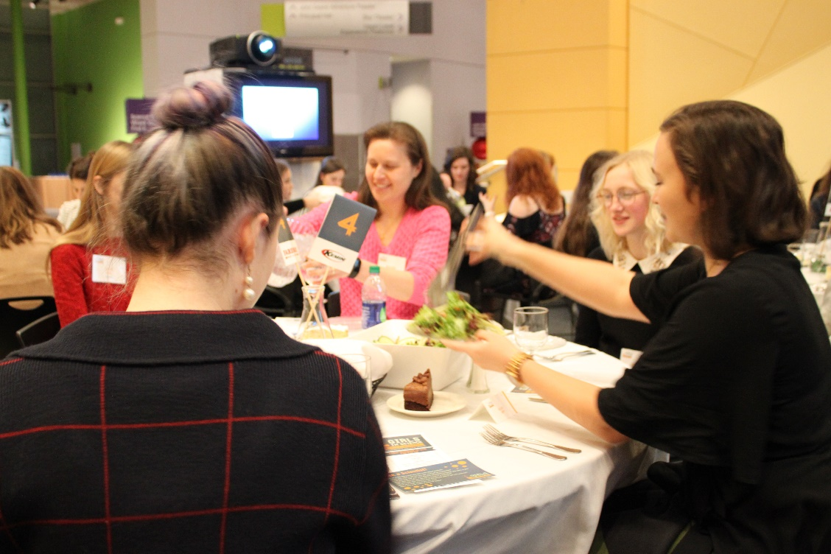
Girls in Science Meals with Mentors
Notes:
Targeted for girls in grades 7 through 12, Meals with Mentors facilitates the opportunity for middle and high school students to meet female undergraduates studying for a degree in a STEM field as well as working female scientists. Two scientists sponsoring companies are seated at dinner tables with, five students in grades 7-12, and one undergraduate studying for a STEM career. The evening includes interactive activities and a keynote speech from a featured female scientist.

Slide 11
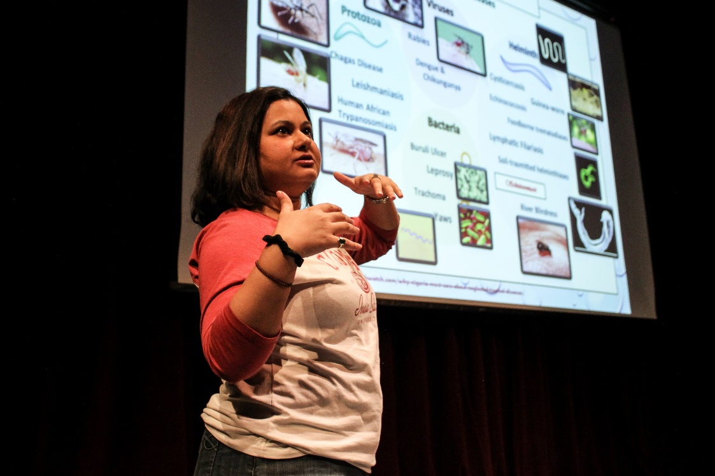
Girls in Science Coffee & Careers
What does a mechanical engineer actually do? What’s a day in the life of an entomologist like? What job lets you combine loves of technology and fashion? SCI’s inaugural Girls in Science “Coffee & Careers” event invites junior and senior girls to a fun and fast-paced morning where 10 local women in STEM careers will share their story in just 6 minutes and 40 seconds each… Only long enough to pique some interest! Following the presentations, the students and scientists will enjoy a continental breakfast and the opportunity to chat about what it’s like to be a girl/woman in science.

Slide 12
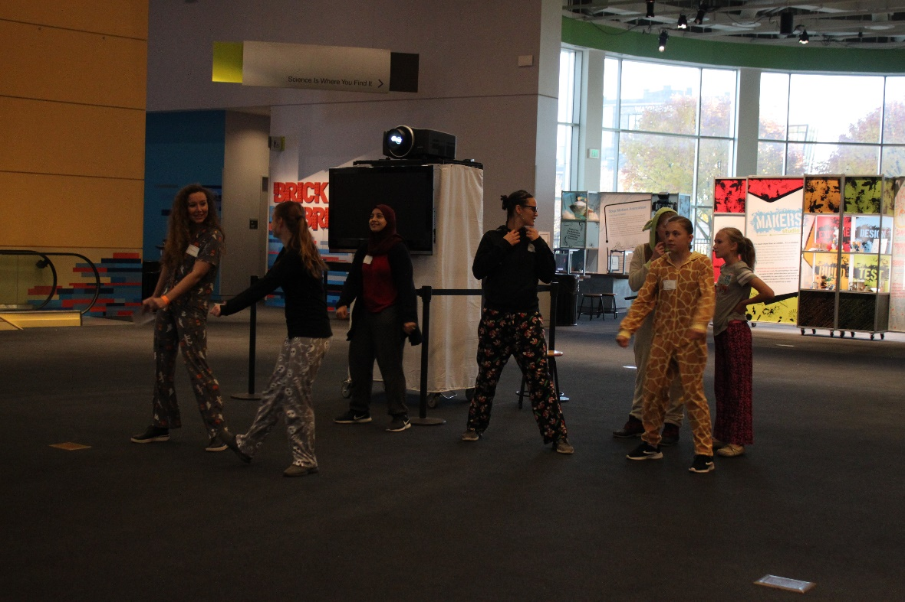
Girls in Science Camps
SCI offers a SciGirls ® weeklong summer camp in June as well as a 1-day winter camp in December. Camp activities work to ignite interest in STEM by asking participant girls questions such as: Do you like to create things? Are you an artist? Does taking care of animals make you happy? Are you an inventor? Do you like figuring out how things work? Are you interested in the world around you?

Slide 13
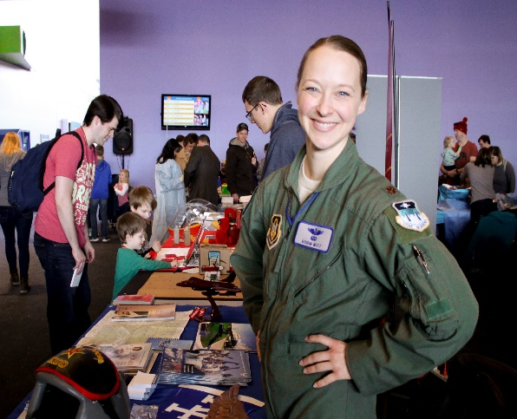
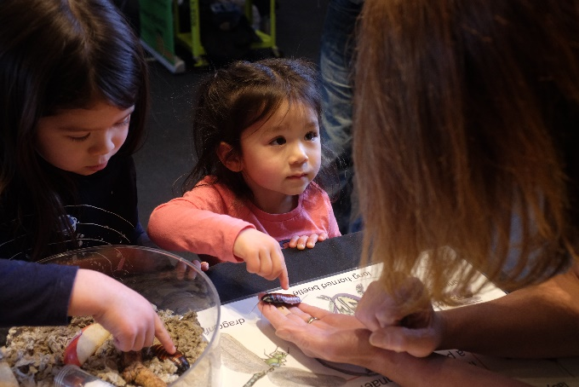
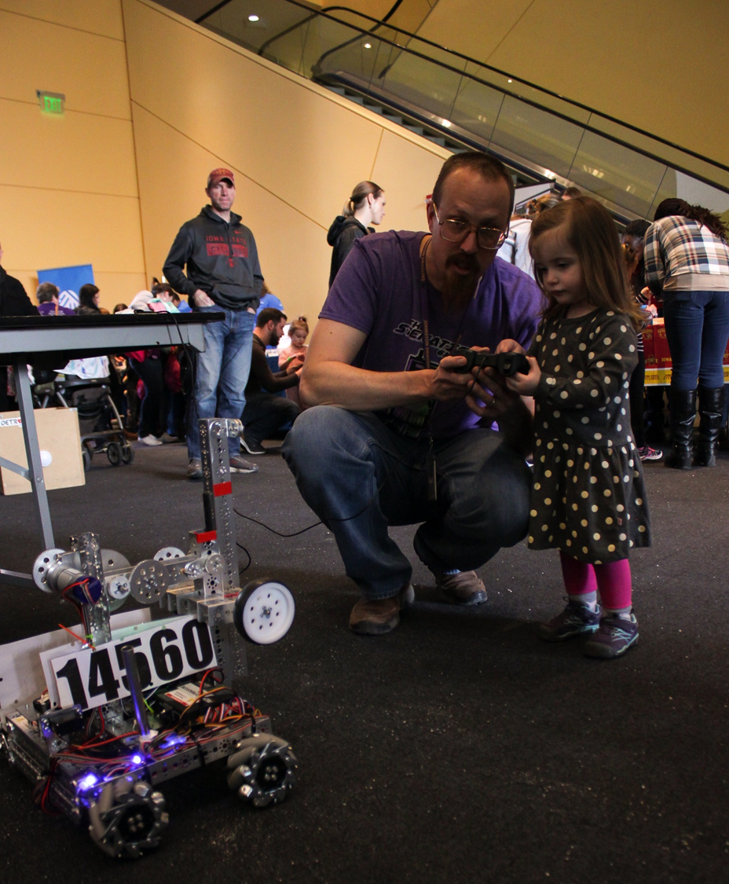
Girls in Science Festival
The goal of this third annual Girls in Science Festival is to expose girls to a variety of STEM careers, allow them to connect with role models and mentors, and inspire them pursue a STEM career path. The event features live science demonstrations and interactive exercises where women students and professionals share their experiences with participant girls. Also included are event workshops aimed at encouraging participation and building the confidence of visiting girls. Training uses resources from SciGirls ® and Portal to the Public, a national collaboration of museums and science centers that work to connect scientists to public audiences.

Slide 14
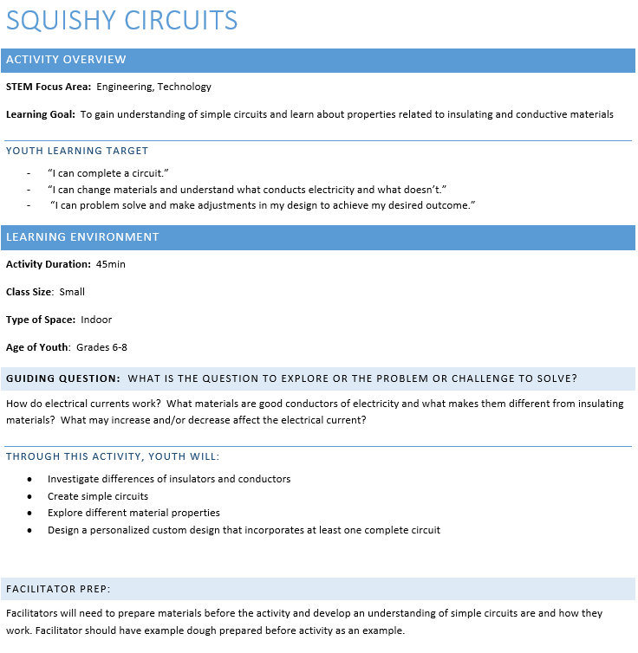

Slide 15
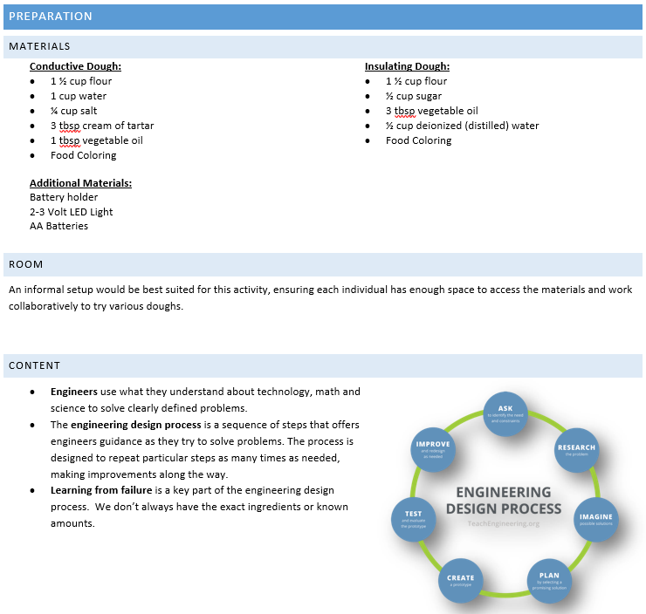
Notes:
Organization: I practiced the activity/technology, prepared materials/extras/place to record youth ideas, and completed an activity (including timings).
Materials: Materials are appropriate for teaching the learning goals; youth will be able to use them and will think they are appealing.
Space Utilization: The space is set up appropriately for the activity and there will be no safety issues or distractions.
Relevance: I have researched why the content matters to youth’s everyday lives.
Content Learning: I have become familiar with the content.
Inquiry: I have become familiar with how authentic, age-appropriate inquiry practices look in this activity.

Slide 16
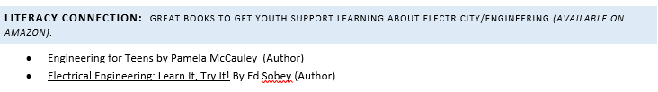
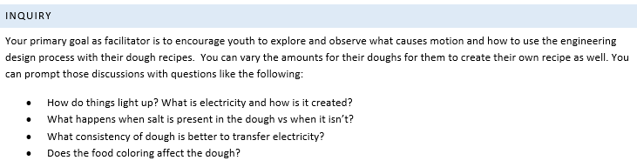
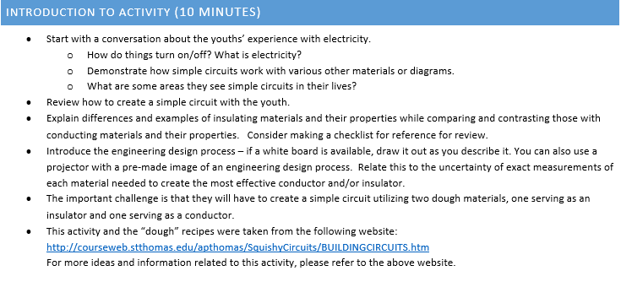
Notes:
Purposeful Activities: This intro section gets youth on track for the learning goal.
Inquiry: I have become familiar with how authentic, age-appropriate inquiry practices look in this activity.
Relationships: I will make each youth feel welcome.
Relevance: I will start to guide the youth in a sustained discussion of how the activity relates to their everyday lives.

Slide 17
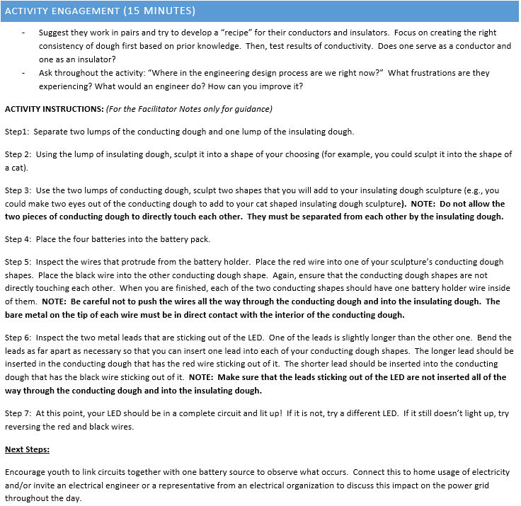
Notes:
Participation: All youth will have access to the activity.
Purposeful Activities: This core section helps youth to move toward the learning goal.
Engagement: This activity has youth physically and mentally engaged with their hands and their minds.
Reflection: If appropriate, I will ask youth questions during the core activity that will help them make sense of what they are learning.
Relationships: I will take steps to share my enthusiasm and create a nurturing, safe learning environment.
DoS: Authentic Stem Practices
Making Predictions and hypothesize
Measure materials
Observations & Investigations
Share and communicate data
Test and revise
Draw conclusions and relationships with materials and content
Have voice and agency, make decisions and guide their own learning

Slide 18
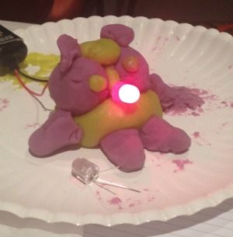
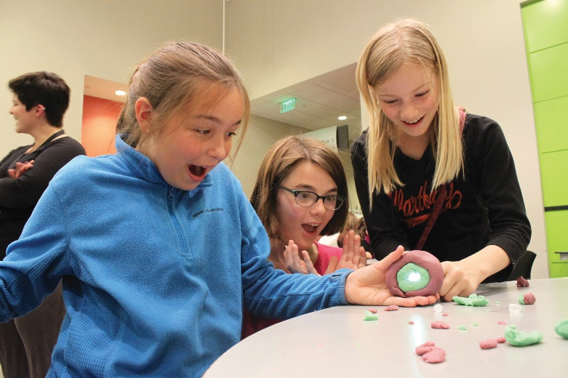
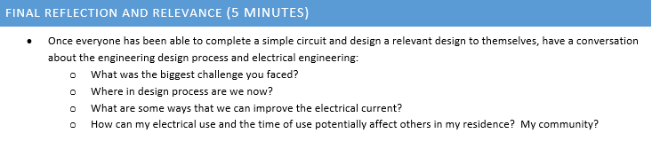
SciGirls Seven
Girls benefit from collaboration, especially when they can participate and communicate fairly
Girls are motivated by projects they find personally relevant and meaningful
Girls enjoy hands-on, open-ended projects and investigations.
Girls are motivated when they can approach projects in their own way, applying their creativity, unique talents, and preferred learning styles.
Girls’ confidence and performance improves in response to specific, positive feedback on things they can control—such as effort, strategies, and behaviors
Girls gain confidence and trust in their own reasoning when encouraged to think critically
Girls benefit from relationships with role models and mentors.
Notes:
Purposeful Activities: The closing section helps youth to reach the learning goal.
Content Learning: I will help youth make connections between different ideas. I will create opportunities for youth to ask questions/provide ideas that show a deeper level of understanding.
Reflection. I will provide youth with a sustained opportunity to make sense of their learning.
Relevance: I will guide the youth in a sustained discussion of how the activity relates to their everyday lives.

Slide 19
WHO WE SERVE
EARLY CHILDHOOD
Onsite experience, School Groups, Camps, SCI Preschool, Pint Size Science & Toddler-Edition classes, Family STEM Institute
YOUTH
Onsite experience, School Groups & Labs, Camps, Girls in Science Initiative,
Events (FIRST LEGO League, Ready Set Build, Des Moines Mini Maker Faire)
HIGH SCHOOL
Onsite experience, School Groups & Labs, Jr. Camp Counselors, Girls in Science Initiative, Events (LIVE! From The Heart, Pantheon Project), Volunteer Opportunities
EARLY- & MID-CAREER
Onsite experience, Mixology Night, Star Parties, Des Moines Mini Maker Faire,
Volunteer Opportunities (mentors for Girls in Science programs)
LIFELONG LEARNERS
Onsite experience, Mixology Night, Star Parties, Family STEM Institute,
Volunteer Opportunities (science communication volunteers)

Slide 20
Resources:
http://tpt.vo.llnwd.net/o26/scigirls/ScigirlsSeven_Print.pdf
https://www.astc.org/ifthen/about-the-if-then-collection/

